Slide 1





Data Preprocessing and ETL

Slide 2
Agenda
What is Data
Machine Learning
Data Preprocessing
Feature Transformations
Data Cleaning or Cleansing
Work with Missing data
Detect and Handle Outliers
Work with Categorical data
Split data to Train and Test Sets
Deal with Imbalanced classes
Feature Scaling

Slide 3
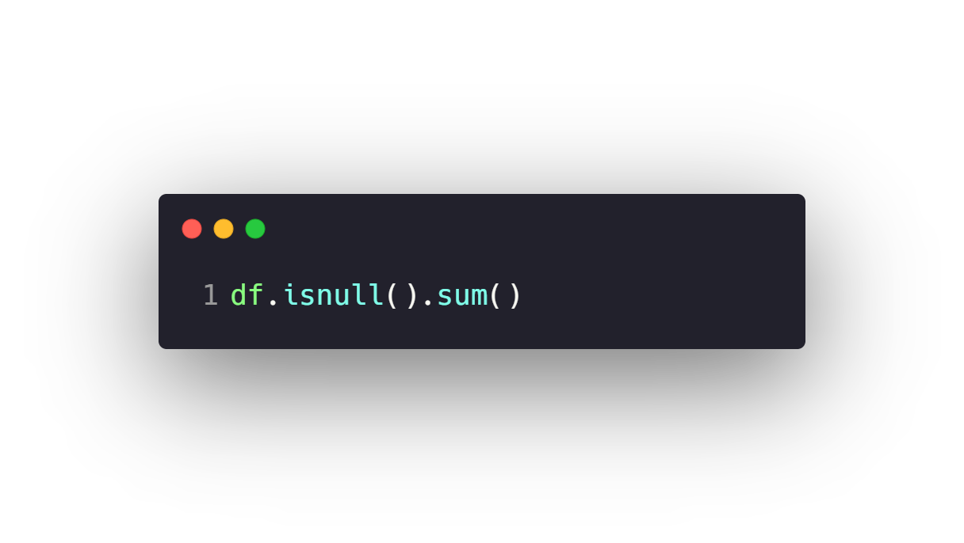



Work with Missing data
Check Missing Data
Drop Missing Data
Fill Missing data with Pandas
Fill Missing data with ML

Slide 4
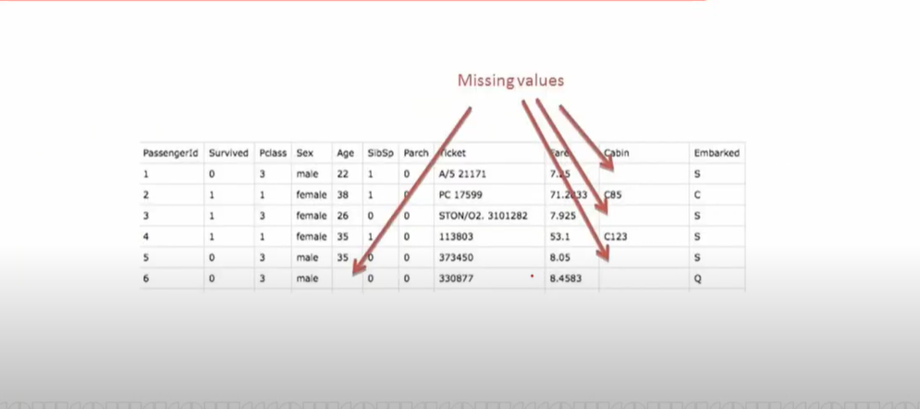

Slide 5
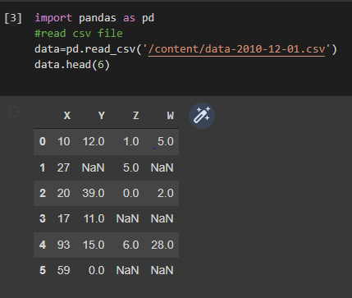
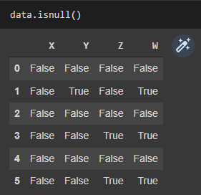
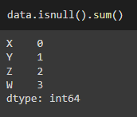
Check missing data
In Pandas missing data is represented by two value: None/NaN
we use a function isnull() to check even if NAN is true/false
we use a function isnull() to check number of nan in each column

Slide 6
Drop Missing Data
1.When the data goes missing on 70–80 percent of the variable:
dropping the variable should be considered
2. When the data goes missing on 1–5 percent of the variable
dropping missing values only should be considered
dropna( axis=0, how="any", subset=None, inplace=False)
axis: possible values are {0 or ‘index’, 1 or ‘columns’}, default 0. If 0, drop rows with null values. If 1, drop columns with missing values.
how: possible values are {‘any’, ‘all’}, default ‘any’. If ‘any’, drop the row/column if any of the values is null. If ‘all’, drop the row/column if all the values are missing.
subset: specifies the rows/columns to look for null values.
inplace: a boolean value. If True, the source DataFrame is changed and None is returned

Slide 7
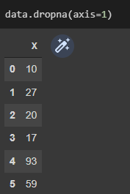
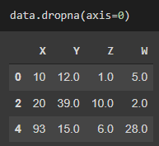
Dropping rows/columns with at least 1 null value
Rows
columns

Slide 8
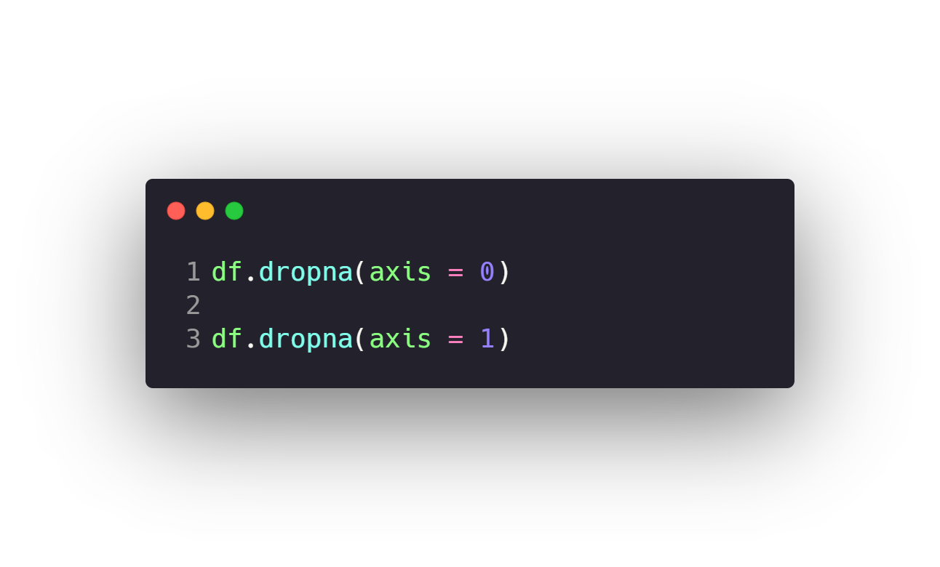
Work with Missing data
Check Missing Data
Drop Missing Data
Fill Missing data with Pandas
Fill Missing data with ML

Slide 9
Fill Missing data with Pandas
Filling the missing data with the mean or median value if it’s a numerical variable.
Filling the missing data with the median value only if it’s a numerical variable with outliers
Filling the missing data with mode if it’s a categorical value.

Slide 10
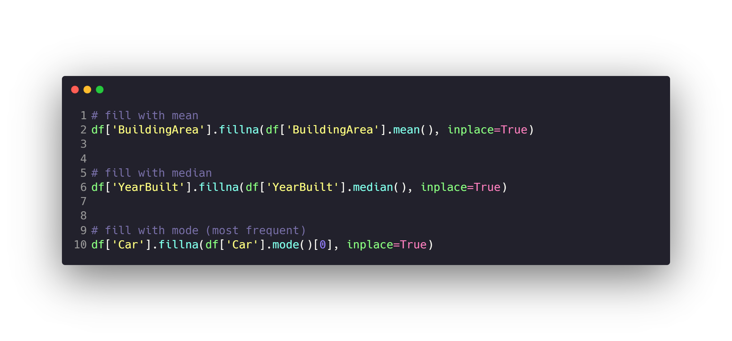
Work with Missing data
Check Missing Data
Drop Missing Data
Fill Missing data with Pandas
Fill Missing data with ML

Slide 11
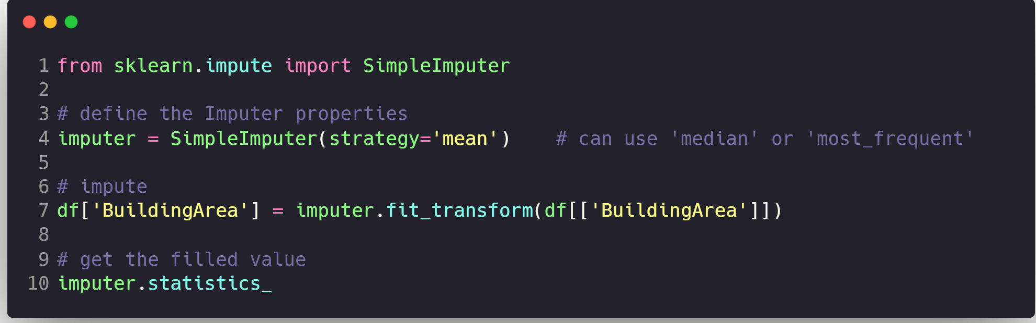
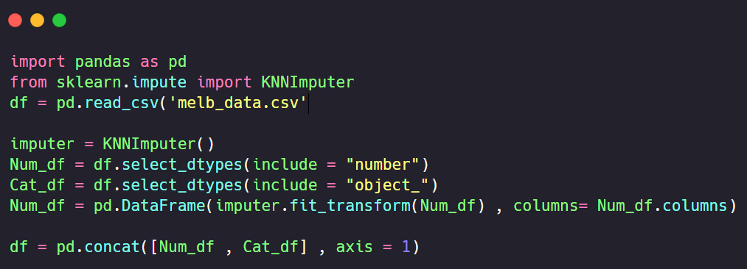
Task 1
Read the dataset “friends_mod.csv”
Use the fillna method and simpleimputer :
Impute the missing values in “height(cm)” column
Impute the missing values in “section” column
Save the dataset after modification with
df.to_csv(“friends_mod.csv” , index = False )
Please take care of outliers and unclean in the two columns.

Slide 12
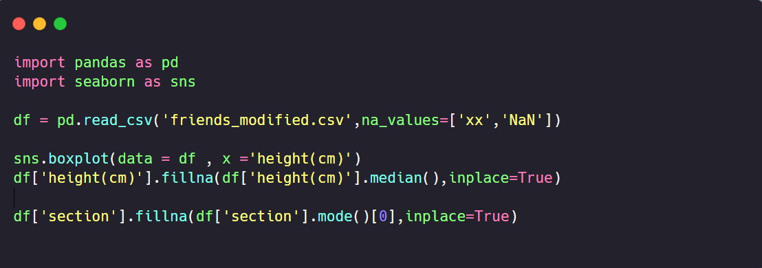
Task 1 Solution

